Slide 1

The State of eCommerce
ARA CEO Forum

Slide 2



2024 Inside Australian
Online Shopping
eCommerce industry report

Slide 3

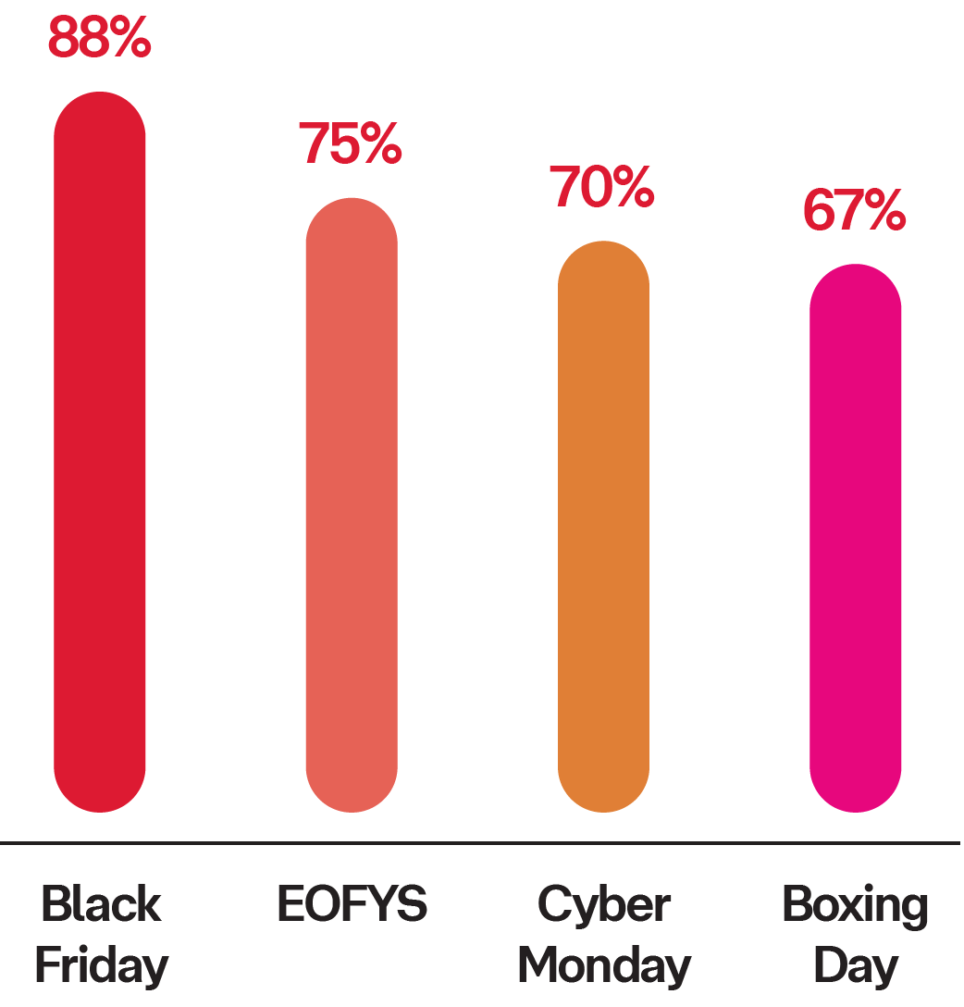
The Strategic Shopper
Online sales events accelerated in popularity
Online purchase volume by week
Cyber Monday
Black Friday
Growth in online purchases during sales events (2023 vs 2019)
AfterPay Day
Number of online purchases
Jan
Feb
Mar
Apr
May
Jun
Jul
Aug
Sep
Oct
Nov
Dec
Notes:
Are retailers pulling forward sales events?
Are we prolonging sales event?

Slide 4

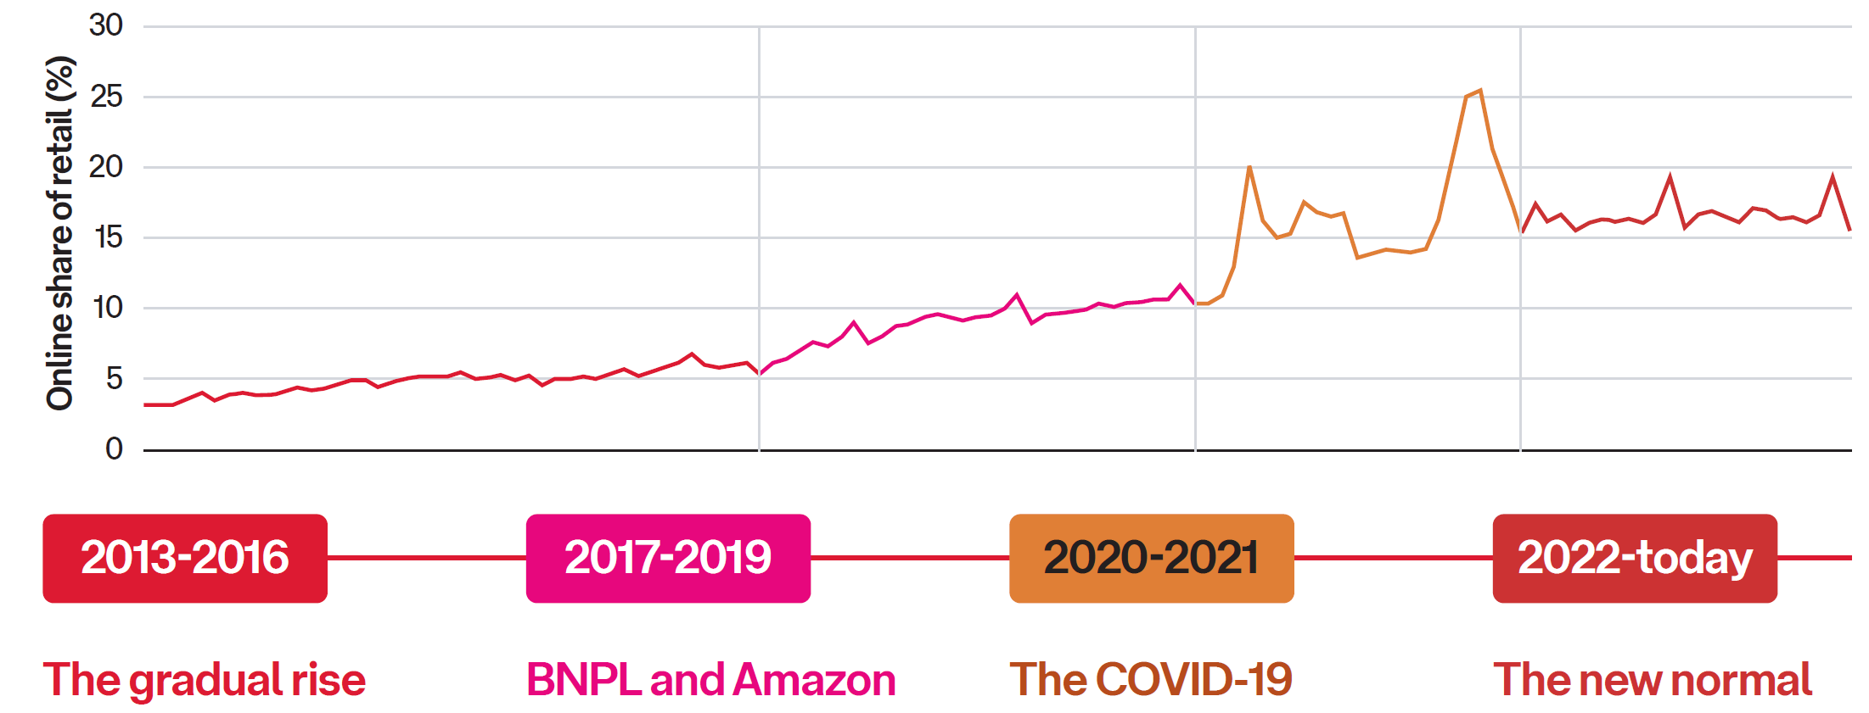

State of eCommerce
Online shopping is here to stay
Online share of retail spend ¹
Online share of retail spend 2023:
“During the height of the pandemic, 1 in 4 retail dollars was spent online”
16.8%¹
1. Online Retail Turnover Non-Food; Retail turnover (seasonally adjusted) minus Cafes, restaurants & takeaway and Food retailing, ABS, Jan 2024.

Slide 5



Across the Generations
Consumer spending by generation
online
Online penetration
by generation*
In-store
Gen Z Gen Y Gen X
Baby Boomers
Gen Z (18-25)
Gen Y (27-43)
Gen X (47-59)
Baby Boomers (60-78)
Sustainability conscious
The Impatient
Value shoppers
Online novices
$10.6b
Online spend
$22.1b
Online spend
$17.5b
Online spend
$12.5b
Online spend
-11%
YoY change in online spend
-2%
YoY change in online spend
+1%
YoY change in online spend
+7%
YoY change in online spend
$80
Average basket size
$95
Average basket size
$110
Average basket size
$109
Average basket size
-6%
YoY change in basket size
-6%
YoY change in basket size
-5%
YoY change in basket size
-3%
YoY change in basket size
Source: CommBank iQ, Jan 2024
*Online penetration by generation = [generation online spend]/ [generation online & In-store spend]

Slide 6




Across the Generations
How the generations like to shop online
Gen Z Gen Y Gen X
Baby Boomers
Preferred category
Fashion
Food & Liquor
Home & Garden
Home & Garden
Gen Z (18-25)
Gen Z (18-25)
Gen Y (27-43)
Gen X (47-59)
Baby Boomers (60-78)
Sustainability conscious
The Impatient
Value shoppers
Online novices
93%
82%
66%
63%
Prefer brands that align with their sustainability values
67%
57%
31%
17%
Chooses another retailer if they offer faster shipping
51%
44%
34%
21%.
Returned an item in the last 12 months
16%
value the convenience of adding Parcel Locker locations in the Australia Post App
24%
love the ability to rename their deliveries in the Australia Post App
34%
highly value the push notifications and real-time updates from the Australia Post App
63%
find the ability to automatically track parcels in the one spot the most important feature of the Australia Post App
Source: CommBank iQ, Jan 2024; Australia Post Omnibus Survey, Nov 2023

Slide 7
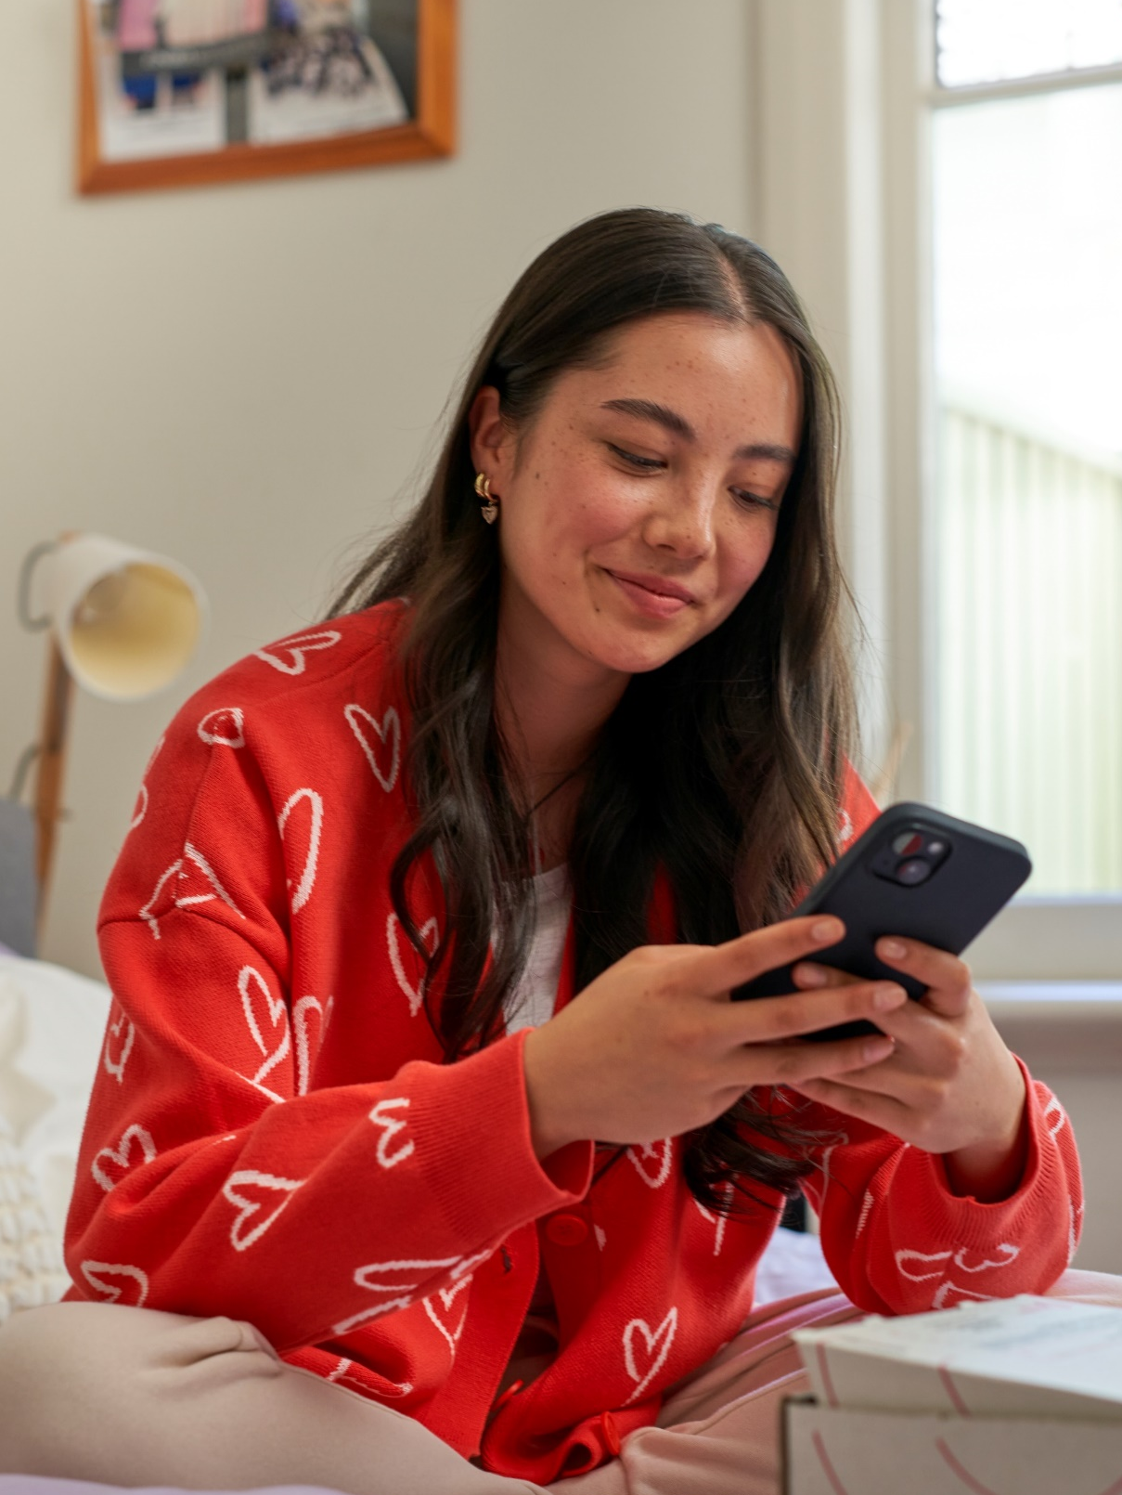




The 2023 Strategic Shopper
The Strategic Shopper
A value driven shopper who is selective with what, where and how they spend their money. Here’s how they’re choosing to shop online in 2023.
Makes smaller, but (slightly) more frequent purchases.
Happy to wait for sales events before making a purchase. We’re seeing growth in key online sales events every year as consumers look for value and save where they can.
Turns to online marketplaces for their shopping. New entrants are disrupting the market, offering low priced items across a variety of categories.
More than 1 in 3 online transactions were purchased from online marketplaces¹
1. CommBank iQ, Jan 2024

Slide 8
Q&A

