Slide 1
Aussie Underdogs and Global Goliaths: Competing in eCommerce
10 April 2025

Slide 2
How eCommerce performed in 2024
$25 billion
9.8 million
Millennials led online spend
+11% YoY ¹
A record 9.8M households shopped online, that’s 82% of all households.
56% of Gen Zs and 45% of Millennials would switch retailers to access out-of-home collection points ²
2.3% YoY
Top locations by volume: Toowoomba, Mackay, Point Cook
Gen Zs
Millennials
$69 billion
$95
16 retailers
Aussies' record-breaking online spend¹
Average basket size
down 2.1% from 2023 and the lowest in 10 years ¹
Average number of online retailers shopped from in 2024
up from 9 in 2018
12% YoY
$16 billion
Online Marketplaces led eCommerce growth
up 23% YoY¹
1. CommBank IQ; 2. Australia Post Omnibus Consumer survey Jul’24

Slide 3
Nearly 40% of online spend growth was driven by Online Marketplaces
Online spend growth contribution by category
(YoY %)
Online Marketplaces drove 39% of all online spend growth in 2024
Online Marketplaces | Food & Liquor | Fashion | Home & Garden | Consumer Electronics | Hobbies & Recreational Goods | Department Stores | Health & Beauty | Books, Stationery & Multimedia | Total
Source: CommBank iQ

Slide 4
Online Marketplaces led eCommerce growth in 2024
Online spend
Growth YoY
12% YoY
 | Online Marketplaces | Food & Liquor | Fashion | Home & Garden | Consumer Electronics | Hobbies & Recreational Goods | Department Stores | Health & Beauty | Books, Stationery & Multimedia
Source: CommBank iQ

Slide 5
ex-China and Amazon could account for more than 50% of all parcels moved across Australia within six years
Amazon, ex-China and Others share of total parcels¹
Other retailers
1% CAGR
8% CAGR
25% CAGR
Amazon
Ex China retailers
7% CAGR
5
© 2025 Australia Post
1. Amazon volumes include Amazon Haul (which also originates from China but is excluded from the “ex-China” section), while the ex-China category covers forecasted volumes for Temu, SHEIN, and AliExpress.

Slide 7
The winning edge
Move beyond current constraints and partner for automation and scale
Understand point of differentiation and take action
Think loyalty, subscription models and fulfilment
© 2025 Australia Post

Slide 8
Recommerce has become a large focus across retail to increase profitability and improve sustainability
Helps solve challenges facing retailers:
Increased
Returns
Sustainability Ambitions
Consumer Thriftiness
© 2025 Australia Post

Slide 9
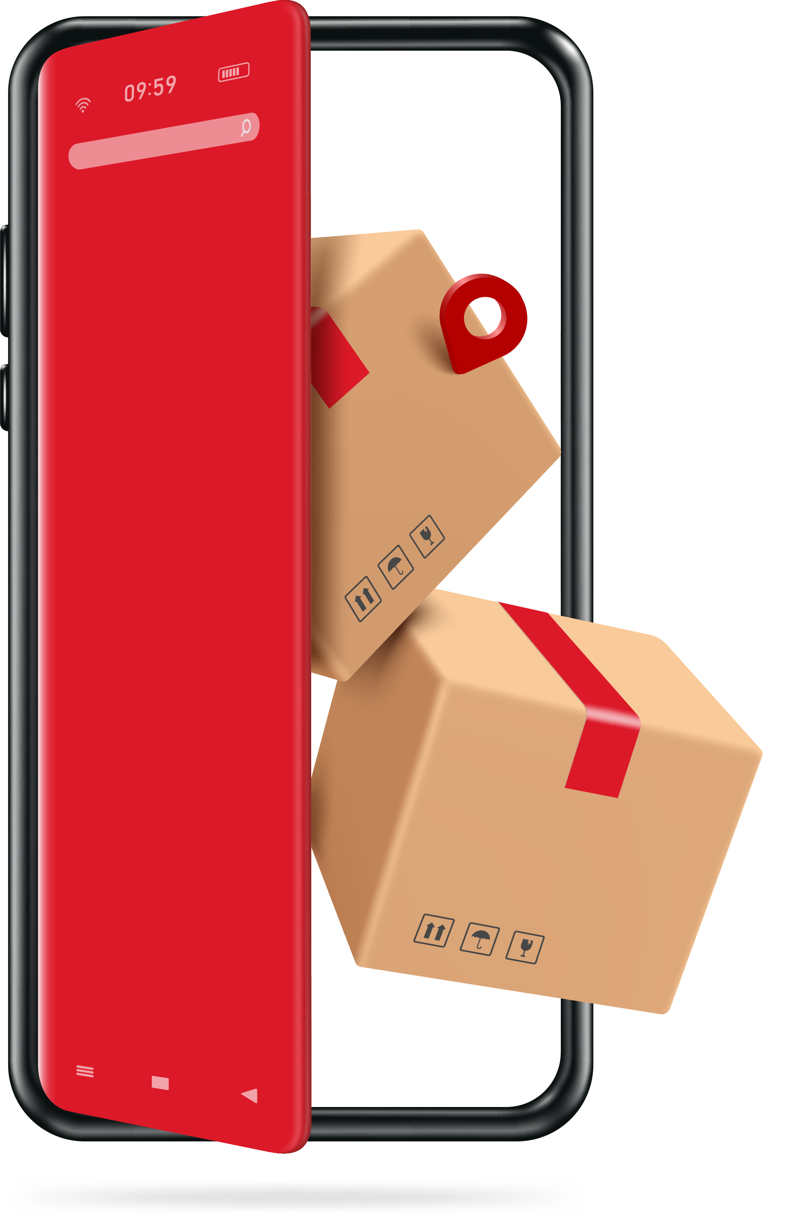
Gen Z & Millennials leading Recommerce
What to expect in the next 5 years
Consumers intend to buy more second-hand goods in the next 5 years²
Gen Z
Millennials
Gen X
Only 7%
Baby Boomers
of shoppers considered sustainability in their purchase decisions¹
Builders
1. Australia Post Omnibus Consumer survey Jul’24 (n=1997); 2. Australia Post Omnibus Consumer survey Nov’24 (n=1997)

Slide 10
Global Recommerce Market
“
$292 million
35% of Australian eCommerce businesses say recommerce will play a role in their strategy in the near future
Estimated USD value of global recommerce market in 2024.
”
x2.5 growth
The rate of retail growth

Slide 11
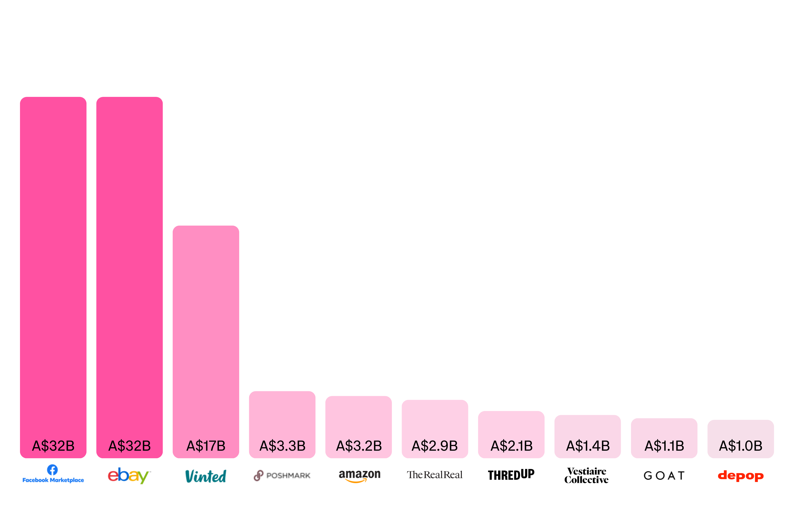
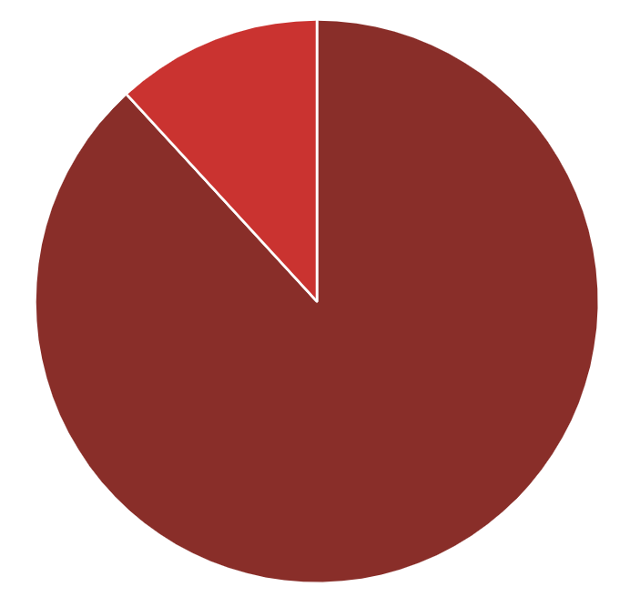
C2C Marketplaces are leading the resale market @ 90%
B2C is 10% of Market
Top Pre-Owned Goods Platforms by GMV

Slide 12
Questions?

Slide 13
Thank You

