Slide 1

Australia’s economic and consumer outlook
David Rumbens
14 November 2024

Slide 2


AUSTRALIA’S ECONOMIC OUTLOOK
The Australian economic environment remains challenging
Australia’s economic environment has been very challenging. A cost of living crisis has been compounded by sharply higher interest rates. At present underlying inflation remains elevated and economic growth is teetering on stagnation.
June quarter GDP data showed growth in the quarter of only 0.2%, and 1.0% over the past year – continuing the per capita recession.
In large part population growth, and a strong labour market, have kept the economy afloat amid a second retail recession and rising business insolvencies.
However, we are likely at or very near the low point in the business cycle.
Tax cuts are providing a notable boost to incomes, along with other cost of living relief, while real wages are now (just) growing. Increasingly this income, and interest rate cuts in 2025, will flow through to consumer spending and more substantial economic growth in 2025.

Slide 3
INFLATION
Underlying inflation is edging down, but not quickly enough yet for the RBA
The Consumer Price Index (CPI) rose 2.8% over the year to September, returning to the RBA’s target band for the first time since 2021.
However, trimmed mean inflation – the Reserve Bank’s preferred measure – remained at 3.5% over the year to September.
The inflation surge was first seen in goods prices, but it has now become more embedded in services prices. The price of goods rose 1.4% over the year to September 2024, but services inflation was 4.6%. This is the second consecutive quarter which has seen an increase in service price inflation.
The Reserve Bank’s statements suggest underlying inflation is expected to reach 3% by June 2025.
Chart 1: Consumer Price Index, headline (annual growth)
Source: ABS Consumer Price Index, Australia.
Chart 2: Annual goods and services inflation
Source: ABS Consumer Price Index, Australia.

Slide 4

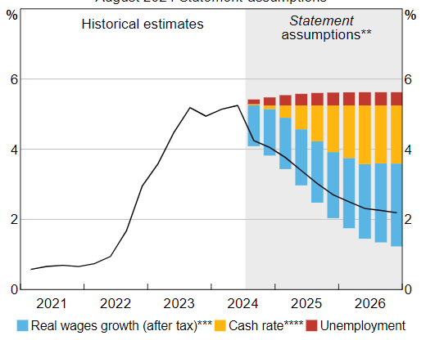
INTEREST RATES
Mortgage rates have choked the economy, but a turning point is near
The cash rate has now remained at 4.35% since November 2023, although messaging from the RBA Board has softened slightly, as Michelle Bullock noted that the RBA Board did not consider a rate rise in the last two Board meetings.
The bulk of market forecasts are for interest rate reductions to commence between February and June 2025.
According to the RBA’s Financial Stability Statement, household budget pressures should be easing from the second half of 2024.
Chart 3: Mortgage payments as a share of household disposable income
Chart 4: Share of borrower with a cash shortfall
Source: RBA; APRA; ABS Australian National Accounts: National Income, Expenditure and Product.
Source: RBA Financial Stability Review.

Slide 5

GLOBAL POLITICS
Global economic and trade disruptions could get more significant
The most significant policy proposals outlined by the Trump campaign relate to higher import tariffs, corporate and personal income tax cuts, immigration, climate change and energy, and foreign policy.
Overall, growth in the US is expected to accelerate in the near term due to an expected surge in consumer sentiment, tax cuts, and deregulation. However, several factors are likely to slow growth in the medium to long term, including higher government debt, increased trade frictions, labour market shortages, higher inflation and general uncertainty.
The implications for Australia are likely to be through trade and exchange rate channels.
A structural slowdown in China could be exacerbated if the US imposes a 60% tariff on all goods imported from China. Slower growth in China is likely to weigh on economic growth in Australia.
Tariffs, expansionary fiscal policy, and deregulation will push US interest rates up and strengthen the US dollar relative to the Australian dollar in the short term.

Slide 6
RETAIL
The path to better retail sales is underway, but may not be apparent until 2025
The period between now to Christmas is still expected to be somewhat difficult for retailers, but perhaps less painful than it has been. Over time, cost of living support and moderating inflation are expected to stoke consumer spending.
2025 and 2026 are expected to show further improvement and a return to more solid growth. Real retail turnover growth is predicted to strengthen from -0.3% in 2024 to 1.5% in both 2025 and 2026.
The retail sector enjoyed a strong September quarter of 2024, with real sales growing 0.5% from the previous quarter. This was the strongest retail sales quarterly performance since June 2022.
Chart 5: Real turnover by category, 2024 and 2025
Chart 6: National real and nominal retail turnover
Source: Deloitte Access Economics; ABS Retail Trade.
Source: Deloitte Access Economics; ABS Retail Trade.

Slide 7
FINANCIAL WELLBEING
Australians’ financial wellbeing is lagging that of other developed nations
Deloitte’s Consumer Signals’ Financial Wellbeing Index shows financial wellbeing in the United Kingdom, United States and globally have been on an upward trajectory over the past year, while Australia has stayed consistently pessimistic.
This shines through sub-indexes in which a higher proportion of Australians are concerned about their savings (50%) and are delaying large purchases (50%). However, a higher proportion are expecting their financial situation to improve within the next year (29%), indicating that financial wellbeing may improve into 2025.
Chart 7: Financial Wellbeing Index (indexed to April 2020)
Source: Deloitte ConsumerSignals.
Note: The higher the index number the greater the level of consumer financial wellbeing.

Slide 8
CONSUMER SPENDING
Spending capacity is not uniform
Discretionary spending has fallen most for those more acutely feeling the cost of living pressures.
Spending has increased most significantly for older age cohorts, who are less likely to hold mortgages.
Chart 8: Change essential spending* (nominal) per capita by age (annual change to March 2024)
Chart 9: Change in discretionary spending (nominal) per capita by age (annual change to March 2024)
Source: Commonwealth Bank of Australia.
Source: Commonwealth Bank of Australia.
* Essential spending excluding housing expenses.

Slide 9
LABOUR MARKET
Employment growth remains strong, but this largely reflects the non-market sector
Employment growth has remained strong. In the first nine months of 2024 a net 373,780 people have gained employment, averaging 41,530 a month – almost double the pre-pandemic average.
However, a very large share of employment growth in 2024 has been driven by the non-market economy. In the year to June 2024 83% of employment gains were attributable to the non-market sector.
Employment in the retail sector has rebounded in 2024, recovering the employment losses which were seen in 2023.
Chart 12: Employed persons, annual change (000s)
Chart 13: Number of people employed in Retail trade (000s)
Source: ABS Labour Force Survey; ABS Job Vacancies; Deloitte Access Economics.
Note: The Australian jobs gap is calculated as the sum of labour demand (job vacancies and employment) from which labour supply (labour force) is subtracted and shown as a share of labour supply.
Source: ABS Labour Account; Deloitte Access Economics.
Notes:
From Hamish in EF and FYBO

Slide 10
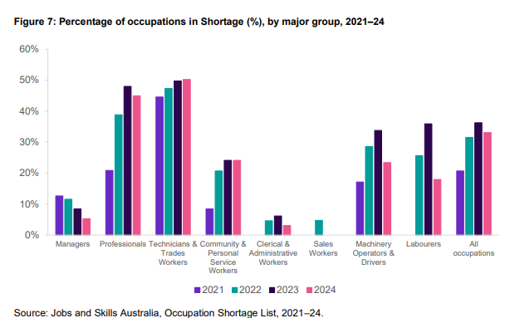
LABOUR MARKET
The retail sector has seen a decline in workforce shortage pressures
The share of occupations in shortage in Australia has declined slightly from 36.2% in 2023, to 33.1% in 2024.
Workforce shortage pressures have loosened in the Retail sector particularly, with shortages in Retail trade falling from 46.2% in 2023 to 18.7% in 2024. Looking at shortages by occupation, 4.8% of occupations within the Sales Workers major group were in shortage in 2022. This has fallen to zero for each of the last two years.
Chart 14: Percentage of occupations in Shortage (%) major group, 2021-24
Chart 15: Workforce shortage pressures – Retail trade
Source: Jobs and Skills Australia, Occupation Shortage List, 2021-24
Source: Jobs and Skills Australia, Occupation Shortage List, 2021-24
Notes:
Email from Andy on JSA

Slide 11
RETAIL BUSINESS PERFORMANCE
Retail profits, retail insolvencies and retail productivity
The Retail trade industry, has seen a decline in profit margins from a recent peak in 2021, now falling to their lowest levels since the start of the pandemic
Weak demand and falling margins have squeezed businesses across the economy and in the retail sector in particular. More than 1,000 retail businesses became insolvent over the year to September 2024. However, there does appear to be a reversal of these trends in recent months.
Chart 16: Rolling 3-month insolvencies count by industry
Chart 17: Average profit year to June - Retail trade
Source: ASIC, Australian insolvency statistics
Source: ABS, Estimates of Industry Multifactor Productivity

Slide 12
RETAIL BUSINESS PERFORMANCE
Business imperatives for the year ahead
Retailers will continue to grapple with a number of challenges over the next year, including sluggish consumer spending and skills shortages. However, businesses should have the following in mind:
As consumer confidence recovers, consumers will prioritise brands that they trust.
Different groups of consumers will continue to spend differently in the year ahead.
Consumers will look to brands they trust
Consumer segments to diverge further
Productivity should be front and centre
Improving productivity will be critical to remain competitive in a rapidly changing marketplace.
Retailers need to invest early to prepare for the future.
Invest in workforce
The skills needed in the industry continue to evolve with increasing automation.
Training must keep up with technological changes.

Slide 13
HIGH RISK CONFIDENTIAL
CONFIDENTIAL
PUBLIC

