Slide 1
“Just another day in retail”: Understanding sexual harassment in the Australian retail industry
Presentation to ARA
Professor Rae Cooper, AO
(on behalf of research team)
The Australian Centre for Gender Equality and Inclusion @ Work

Slide 2
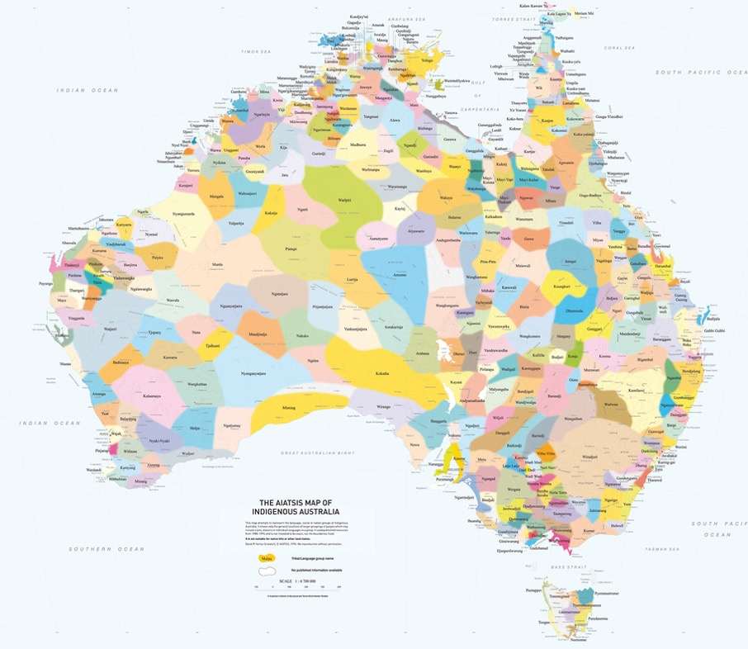
Acknowledgement of Country: We acknowledge traditional custodianship of the land on which our research team works, the Gadi people of the Eora Nation. We acknowledge Elders past and present, and we pay our respects to Aboriginal and Torres Strait Islander people with us today.

Slide 3
The Australian Centre for Gender Equality and Inclusion @ Work
We deliver research insights on the drivers of gender inequality at work and develop evidence-based actions for governments, business, unions and civil society to make work more equitable & productive. The research team are united by the aim to build structural and cultural change in the labour market and across industries, in organisations and jobs.
Our four research pillars:
1. Designing gender equality into the future of work
2. Addressing gender segregations in the labour market to build sustainable careers
3. Building alignment in work and care regimes that work for everyone
4. Motivating respectful, inclusive work cultures where all workers thrive
We welcome conversations about collaborative research
Page 4

Slide 4
Some context: Why retail?
The retail industry employs 9% of all Australian employees (ABS 2022a).
Thirty-two per cent (32%) of all retail workers are employed casually (without entitlements) (ABS, 2023)
Twenty-five per cent (25%) of retail employees are aged 15–19 years (ABS, 2021), making retail the second largest employer of young workers (ABS, 2022b).
Fifty-six per cent (56%) of retail employees are women (it’s the 3rd most feminised industry in Australia (ABS, 2022c; ABS 2024).
Forty-nine (49)% employed in retail are classified as sales assistants, salespersons or cashiers, with women comprising 78% per cent of these roles (ABS, 2023),
Women make up (43.2%) of top earners and 49% all managers in retail (WGEA, 2023).

Slide 5
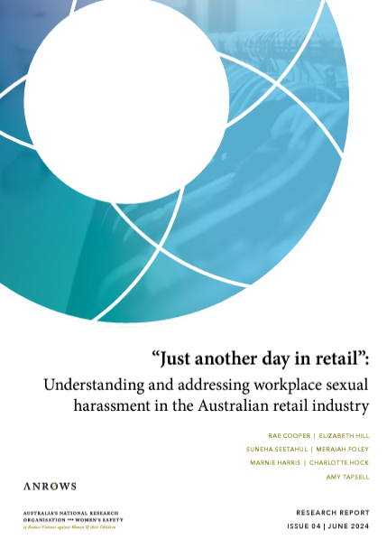
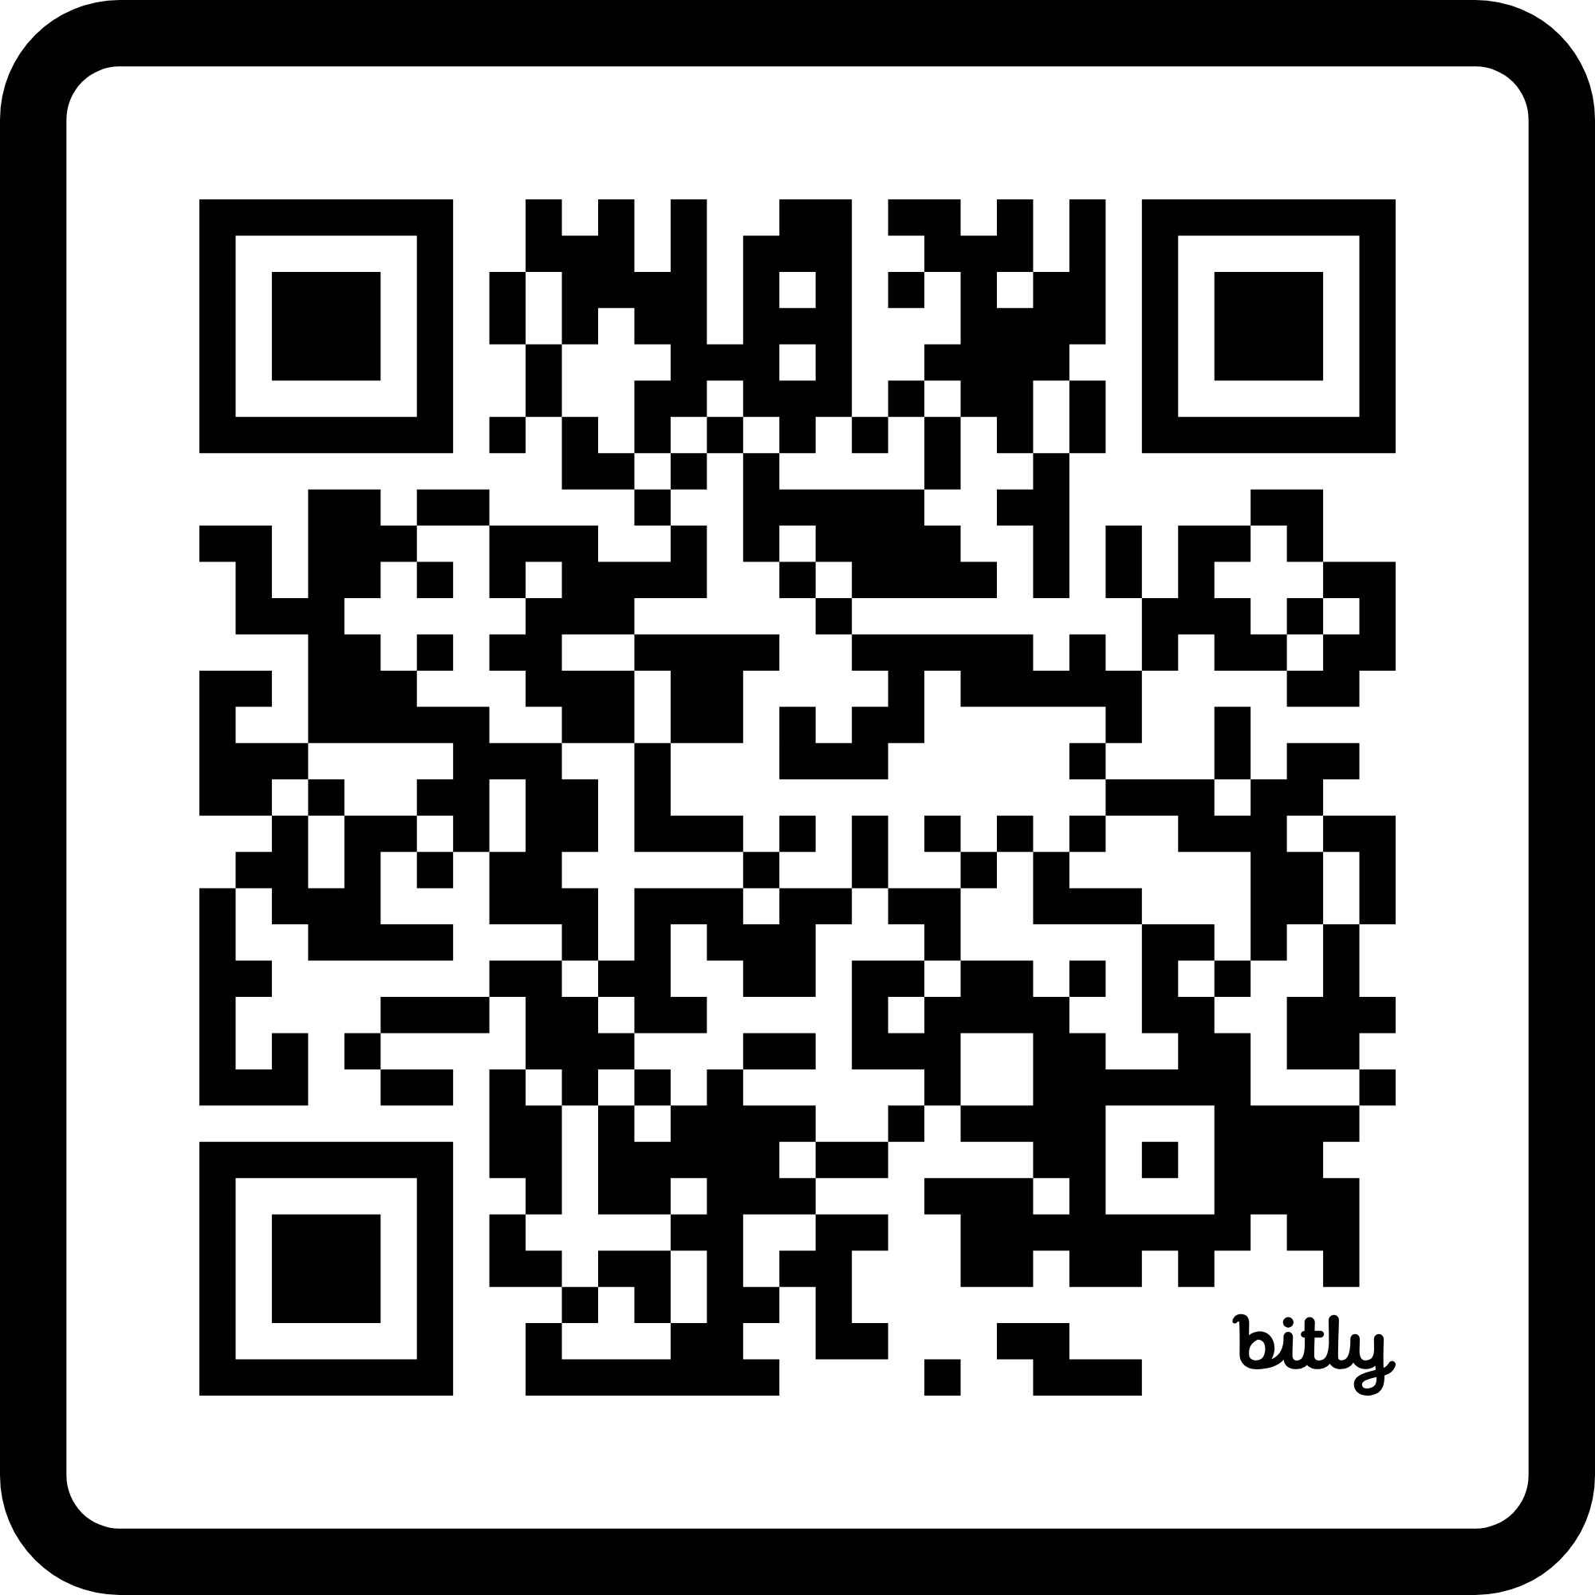
“Just another day in retail” report available here:
Suggested citation: Cooper et al (2024)

Slide 6
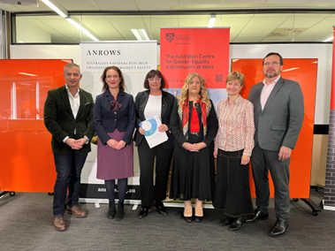
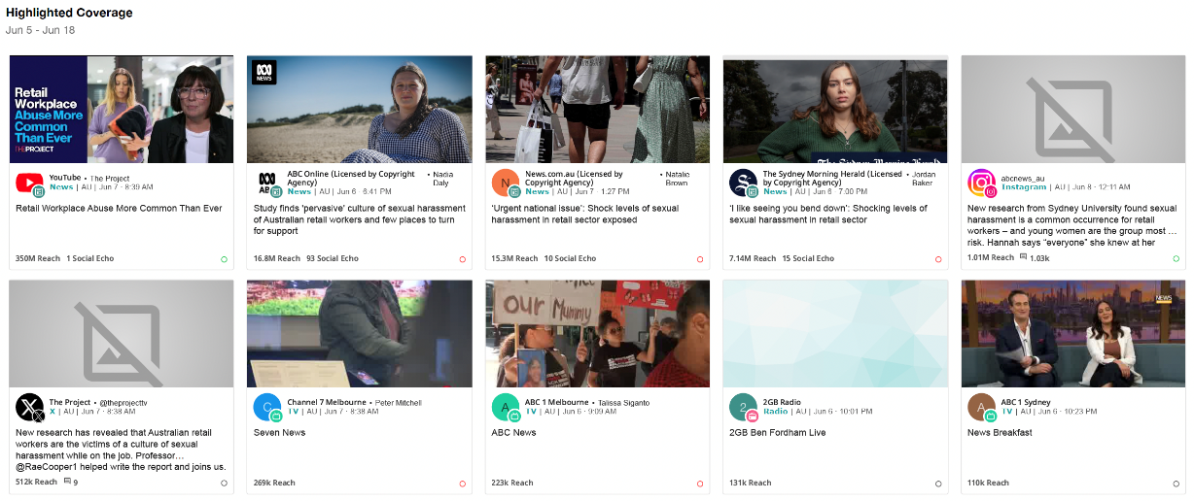
Report media engagement and impact: Hit a nerve
457
total mentions
485k
estimated views
412m
total reach
Online
29
mentions
Radio
310
mentions
TV
91
mentions
Print
3
mentions
Social media
24
mentions
Jun 5 – Jun 18
Page 18

Slide 7
Methodology – Three Phase Approach (plus industry co-design and feedback)
Four large survey data sets: 1) Australian Human Rights Commission (AHRC) (2022), 2) Australian Human Rights Commission (AHRC) (2019), 3) The Designing Gender Equality into the Future of Work (2022) and 4) The Australian Women’s Working Futures (2018) dataset.
1
Fifteen interviews with retail key informants in senior roles (representing large Australian retail employers, retail and associated industry associations, and retail unions) within the retail industry (n = 15).
2
Twelve targeted focus groups with retail managers and workers (10 online focus groups with retail workers and managers, 2 with managers only, 12 total n 56) in key segments of the workforce and industry subsectors
3
Co-design and testing sessions with Expert Advisory Committee feedback, comments, and guidance on report. Included a session each facilitated by the ARA and SDA with leaders in their community.

Slide 8
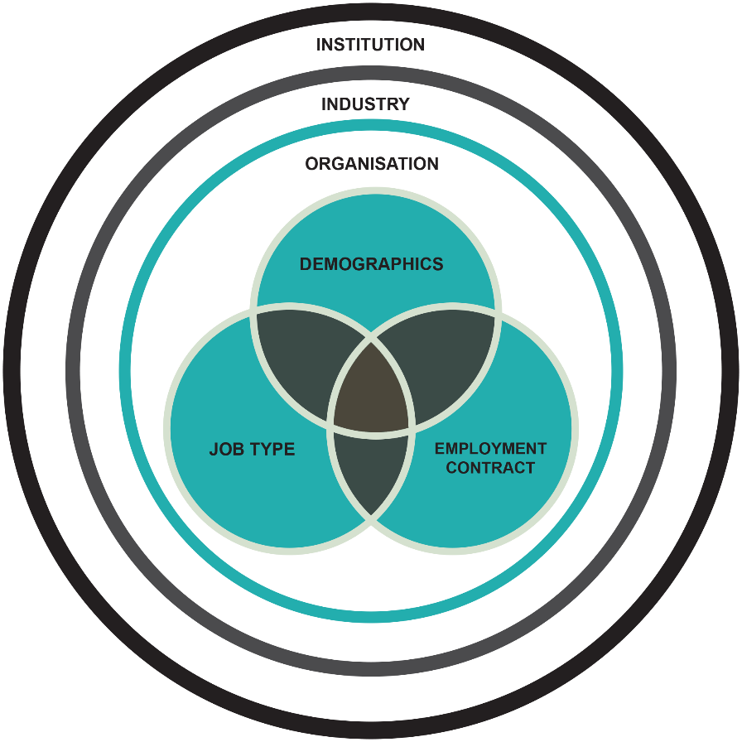
Approach and Model
Modifies Cooper et al.’s (2021) model of gendered dynamics in careers.
Forces at four levels shape experience:
Institutional: regulatory context, behaviours, parties and actions (complaints-based approach but a new ‘positive duty’).
Industry: industry-wide policies and practices and social norms.
Organisational: organisational policies and practices, segment of industry.
Worker demographics and job features: frontline work and nature of product; gender, age, cultural identity; employment contract.
Model informs design of the data collection and data analysis

Slide 9
Key findings, a little data and recommendations - 1
1
Finding 1: Retail is a very high-risk industry for sexual harassment and the experience of sexual harassment is pervasive across retail workplaces.
Recommendation: establishing a Retail Industry Workplace Respect Committee and an industry-wide strategy focused on the prevention and management of sexual harassment.

Slide 10
Key findings, a little data and recommendations - 2
2
Finding 2: The risk of experiencing sexual harassment is heightened for particular groups of retail workers.
Recommendation: data collection which includes the demographic characteristics of targets; targeted strategies to address specific workforce group needs (e.g., awareness campaigns, reporting channels, and support, and collaborating with high-risk workforce members).
We’re just subject to it so regularly, that it’s like water off a duck’s back. … It’s just another day in retail. (Harper, 33, intimate apparel store worker)
Also see previous and next slide

Slide 11
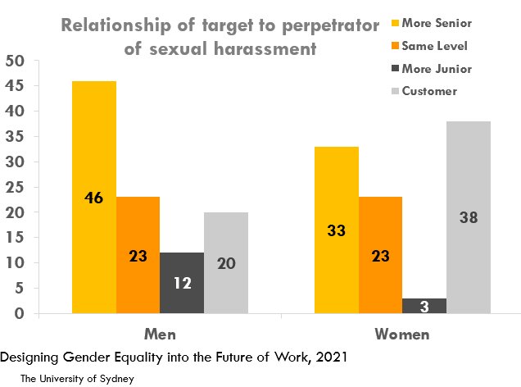
Key findings, a little data and recommendations - 3
3
Finding 3: Retail workers experience sexual harassment that is perpetrated from managers, peers, and customers​.
Recommendation: routine and detailed data on the employee experience of workplace sexual harassment, perpetrators profiles, and points of greatest risk; the sharing of deidentified data-driven information across the retail sector.

Slide 12
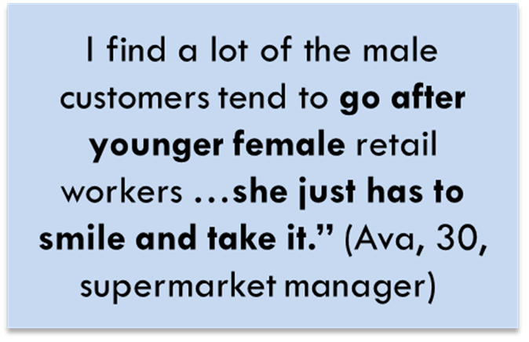
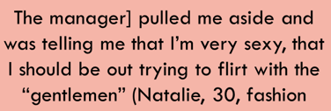
Key findings, a little data and recommendations - 4
4
Finding 4: Customer-perpetrated sexual harassment is a significant problem and is perpetuated and enabled by prevailing industry norms.
Recommendation: collaboration on an industry-wide customer education campaign; clear training and organisational communications to frontline workers and managers; enhancing worker safety through safe staffing CCTV cameras, duress alarms, code words for discreet help requests.

Slide 13
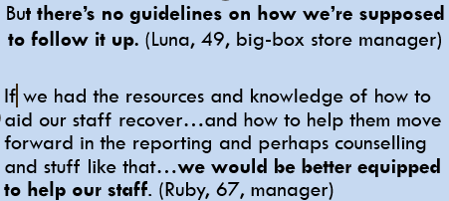
Key findings, a little data and recommendations - 5
5
Finding 5: Organisational policy on how to deal with sexual harassment is inconsistent, information is not easy to access or easy to understand.
Recommendations: industry-wide guidelines encompassing definitions, scope, reporting procedures, and consequences for sexual harassment perpetrators; retail employees need easy access to clear and consistent information about sexual harassment policies and procedures.

Slide 14
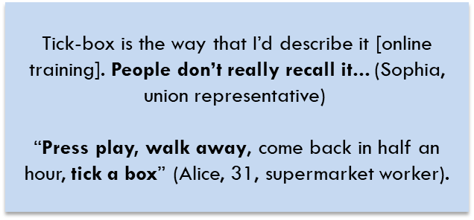
Key findings, a little data and recommendations - 6
6
Finding 6: Organisational and industry-wide training of workers and managers on sexual harassment is inconsistent, infrequent, and poorly targeted​.
Recommendation: tailored employer- and union-delivered training content; regular employer and union-delivered training sessions (a mix of in-person and online); linking employer-provided training to regular team conversations; employer and union-delivered training content and delivery is appropriately trauma-informed.

Slide 15
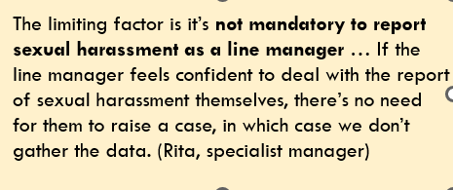
Key findings, a little data and recommendations - 7
7
Finding 7: Sexual harassment data collection and data analysis is non-standardised, limited, and ad-hoc and this limits insights in relation to incidence.
Recommendations: a standardised industry-wide approach to data collection, including conducting regular sector-wide surveys; developing informal and real-time reporting pathways that are easily accessible to employees; data collection methods as a consultative tool.

Slide 16
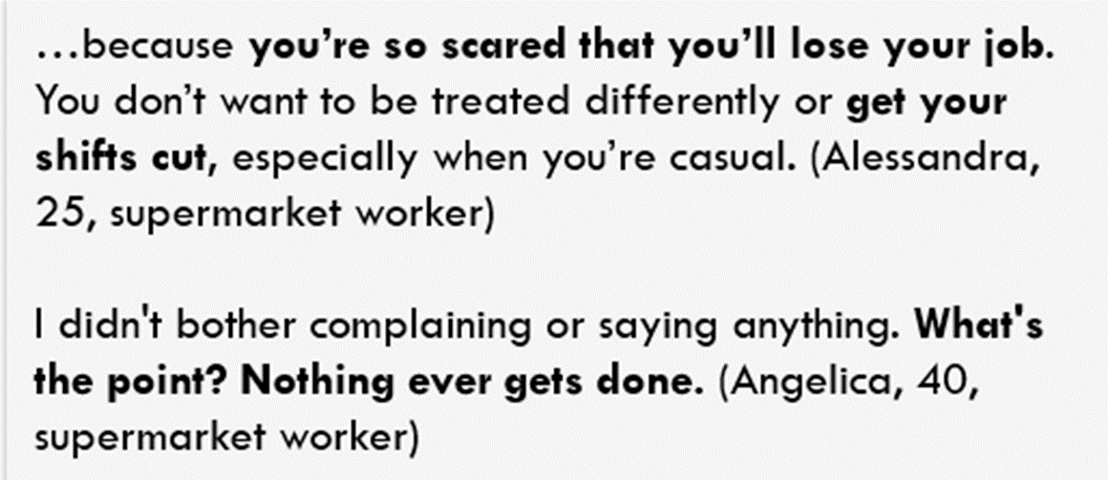
Key findings, a little data and recommendations - 8
8
Finding 8: Complaints and reporting processes are opaque and not trusted by workers.
Recommendation: accessible, confidential, clear and trauma-informed reporting mechanisms; clear protocols to ensure confidentiality and support for complainants and witnesses; explicit protections for complainants; transparency and clear guidance about incident reports.

Slide 17
Key findings, a little data and recommendations - 9 & 10
9
10
Finding 9: HR management and work health and safety managers are the key “owners” of organisational policies and practices, but they lack adequate resources to address sexual harassment.
Recommendation: industry-wide collaboration among specialist managers; improved resources and support for specialist managers.
Finding 10: Supervisors and store managers are the “frontline” in dealing with sexual harassment and they need better support to do this work well.
Recommendation: recognition that line managers play a critical role in supporting employees; appropriate training and resources for line managers; targeted supervisor training to build capacity; policies that foster and encourage supervisor-led discussions of sexual harassment.

Slide 18
Conclusion
Sexual harassment is a systemic and pervasive feature of the retail industry ecosystem
As a major employer (particularly of young Australians and women) sexual harassment in the retail industry is a pressing safety / workplace issue and a nationally significant concern.
We find plenty of room for improvement in the policies and practices of retail organisations (individually and across the ecosystem).
An industry-wide approach (drawing in all stakeholders) is urgently needed to address this urgent issue and these deficiencies

Slide 19
References
Australian Bureau of Statistics (ABS). (2021). Census data 2021 – Custom table. ABS. https://www.abs.gov.au/census.
Australian Bureau of Statistics (ABS). (2022a, November 8). Jobs in Australia. ABS. https://www.abs.gov.au/ statistics/labour/jobs/jobs-australia/2015-16-2019-20.
Australian Bureau of Statistics (ABS). (2022b), December 14). Labour account Australia. ABS. https://www.abs.gov. au/statistics/labour/labour-accounts/labour-accountaustralia/sep-2022.
Australian Bureau of Statistics (ABS). (2022c, August 11). Characteristics spotlight: 2022. ABS. https://www.abs. gov.au/articles/characteristics-spotlight-202
Australian Bureau of Statistics (ABS). (2023). Characteristics of Employment, Australia, 2014-2023. ABS. https://www.abs.gov.au/statistics/labour/earnings-and-working-conditions/characteristics-employment-australia/latest-release
Australian Bureau of Statistics (ABS). (2024). Labour Force, Australia, Detailed. ABS. https://www.abs.gov.au/statistics/labour/employment-and-unemployment/labour-force-australia-detailed/latest-release#data-downloads
Australian Human Rights Commission (AHRC). (2019). Everyone’s business: Survey on sexual harassment of members of the Shop, Distributive and Allied Employees’ Association 2019. ARHC. https://humanrights.gov.au/sites/ default/files/document/publication/ahrc_sda_survey_ report_2019.pd;
Australian Human Rights Commission (AHRC). (2022). Time for respect: Fifth national survey on sexual harassment in Australian workplaces. ARHC. https://humanrights. gov.au/time-for-respect-2022.
Australian Retailers Association (2023). ARA welcomes WGEA Scorecard to drive Gender Equality in Retail. Australian Retailers Association. https://www.retail. org.au/media/ara-welcomes-wgea-scorecard-to-drivegender-equality-in-retail
Australian Women’s Working Futures (2018).
Cooper, R., Baird, M., Foley, M., Oxenbridge, S. (2021). Normative collusion in the industry ecosystem: Explaining women's career pathways and outcomes in investment management. Human Relations, 74(11), 1916-1941.
Cooper, R., Hill, E., Seetahul, S., Foley, M., Harris, M., Hock, C., & Tapsell, A. (2024). “Just another day in retail”: Understanding and addressing workplace sexual harassment in the Australian retail industry (Research report, 04/2024). ANROWS.
Workplace Gender Equality Agency (WGEA). (2023) WGEA Retail Trade Industry Snapshot. WGEA. https://www.wgea.gov.au/data-statistics/industry-snapshots/retail-trade

Slide 20
Thank you
Professor Rae Cooper, AO
The Australian Centre for Gender Equality and Inclusion @ Work
The University of Sydney
rae.cooper@sydney.edu.au ​
Get in touch
The Australian Centre for Gender Equality and Inclusion @ Work
gender-equality@sydney.edu.au

Slide 21
Voluntary engagement about the positive duty
The Australian Human Rights Commission (AHRC) is looking to work with an influential national Retailer interested in collaborating in an ongoing and voluntary capacity about compliance with the new positive duty under the Sex Discrimination Act.
The purpose of the engagement is to:
examine and measure the Retailer’s compliance with the positive duty
remedy any non-compliance using the AHRC’s Guidelines for complying with the positive duty
measure impact over time.
If your business might be interested, please contact Kate McDonald, Director (Policy) Positive Duty Team for a confidential discussion.
kate.mcdonald@humanrights.gov.au
(02) 7904 2135

