Slide 1
The trends shaping Retail in 2024
Laura Demasi, Head of Retail, Social & Consumer Trends

Slide 2
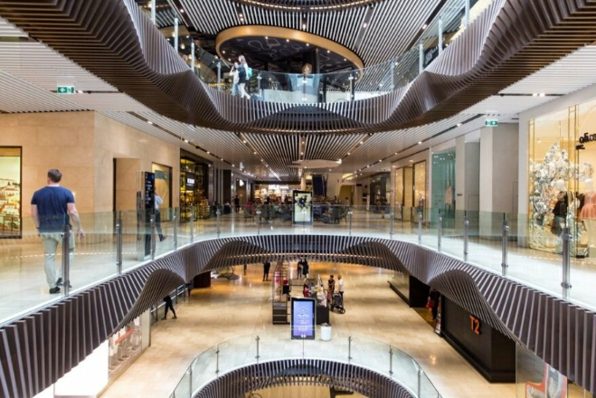
What we’ll cover today:
Broader macroeconomic context
Who’s hit the hardest by the cost-of-living crisis
How consumers are adjusting their spending
The key cohorts who still have spending power
The surprise winners in this environment - ultra cheap online retailers Chinese Temu and Shein
Notes:
Today you’ll discover:
Record population growth is doing the heavy lifting in keeping Australia out of recession
The cost-of-living crisis is hitting young families the most
But other key cohorts still have spending power
Consumers report spending less on some categories but more on others
There are surprise winners in this environment - who are disrupting retail to the tune of $8 billion

Slide 3
The fastest rate of population growth in 72 years did the heavy lifting in avoiding a recession and the retail ‘spending cliff’
ABS Annual population growth since 2002 - % increase each year
Australia's population grew by 2.5% in 12mths to Sep 2023
Growth - Number of people
Net migration added 548,800
people to the population
Half of recent migrants are aged 18-27
Source Australian Bureau of Statistics, Feb 2024
Notes:
Rewinding to early 2023, we feared Australia was on track for a recession as close to 1 million mortgages came out of fixed-interest rate periods – and another half a million to come over 2024.
We all know that this worst-case scenario didn't come to pass.
And that’s because of record population growth – net migration added more than half a million people to our population - which did the heavy lifting to avoid the much-feared retail spending cliff and recession.

Slide 4
Consumer Confidence hovers near historic lows but is performing marginally better than a year ago - now at 80.7 for May 2024
Roy Morgan Consumer Confidence Monthly, Cash Rate and CPI
Covid lockdown
112
IX
79
Consumer Confidence at a historical low for month of July 73.8pts
80.7
Source: Monthly Consumer Confidence: Roy Morgan Single Source, Oct18-Mar24
Base: Australians aged 14+,
Source: Cash Rate Monthly: RBA; CPI Monthly: ABS;
Notes:
Meanwhile, Consumer Confidence continues to hover around historic lows, with the indicator sitting below 80 for much of 2023.
That’s unheard of!
However, in the first quarter of 2024 some green shoots are appearing, with the Index now above 80, marking a turning point as Australians become more hopeful that the rate rise cycle could finally be ending.

Slide 5
Since rate rises commenced in 2022 Consumer Confidence among mortgage holders has plummeted by 27 points, based on weekly results
Consumer Confidence by homeowners, mortgage holders and renters
Weekly result is now back under
80
Source: Roy Morgan Single Source
Base : Total AU Population 18+, Mortgage Holders 18+
Notes:
Unsurprisingly, among Mortgage Holders – who represent more than a third of the population - Consumer Confidence has been hit the hardest, down 21 points since April 2022.

Slide 6
The household savings ratio hit a 16-year low in late 2023 and has barely recovered since
ABS Household savings ratio
Savings now only 0.9% of income
after bottoming out in Sept at 0.2%
Source: Household Savings Ratio Quarterly: ABS; Unemployment Rate Seasonally adjusted Monthly: ABS;
Total Seasonally Adjusted Retail Sales: ABS
Notes:
How is this affecting retail?
Sales continue to remain flat, with households saving less and having less of their incomes to spend.
On this chart – the blue line shows the household savings ratio plummeting at the end of last year to roughly half of what it was before COVID.
The green line shows retail sales.
The relationship between these two is clear, as the savings ratio declines – because the cost of living eats up more of people’s discretionary income - retail sales slow.

Slide 7
Financial stress has increased among all mortgage holders over this period
Source: Roy Morgan Single Source
Base : Australians 18+ with owner occupier home loan
Notes:
At the same time, financial stress has increased among mortgage holders over this period as more people struggle to pay bills and regular expenses.

Slide 8
‘Mortgage Stress’ is near its highest since 2008 - with 30.8% of mortgage holders now ‘At Risk’ - 1,560,000 mortgages
Base: Australians 18+ with owner occupier home loan; July 2007 – April 2024; 3mm data
Source: Roy Morgan Single Source
Notes:
The extreme end of this – Mortgage Stress – calculated from Roy Morgan’s deep data on loans, income and expenditure, is also hovering at a record high
Now 31.4% of Australian mortgage holders now At Risk of Mortgage Stress.
Not surprisingly, those most likely to be At Risk are RECENT mortgage holders – 6 years or less - and single-income households.

Slide 9
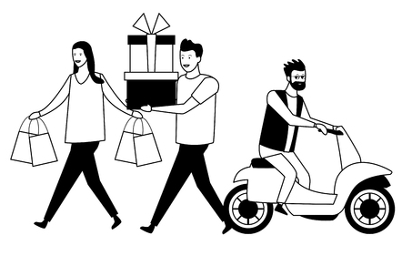
But interest rate rises aren’t affecting everyone, there are still cohorts with spending power
34% of Australians own their own homes outright
Half of 18-29 year-olds live with their parents
1 in 4 properties in Australia are purchased with cash Over half of properties in the Melbourne postcode 3000
Source: Roy Morgan Single Source; 12 months to Mar’24
Base : Total AU Population 18+ The Melbourne Institute HILDA Survey 2024, Australians 14+, Properties purchased with cash: Pexa Property Insights
Notes:
So far, the picture is looking pretty grim ...
It’s important to remember that interest rates don’t directly affect everyone; there are still cohorts with spending power.
People who own their homes outright represent 34% of the population—a significant cohort whose spending power is unaffected.
In addition, many young adults are also free from the burden of rents and mortgages
Just over half of 18 to 29 year-olds still live with their parents
This represents a significant generational change in Australia's demographics.

Slide 10
In the background, Australia is also in the midst of the greatest intergenerational wealth transfer in history
$3.5- $5 trillion
is due to pass from older Australians to the next generation over the next 10-25 years to 2050
$3.5 trillion estimate by Productivity Commission released in 2021, projection to 2050 $5 trillion estimate by JBWere, released in March 2024, projection to 2034

Slide 11
A closer look at what consumers are telling us about how they’re adjusting their spending
Notes:
Let’s take a closer look at what consumers are telling us about how they are adjusting their retail spending ...

Slide 12
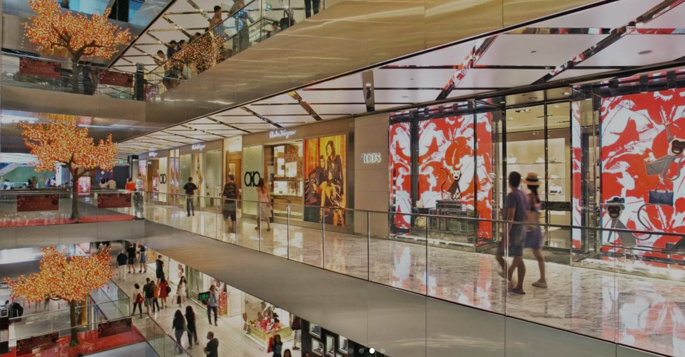
Consumers are telling us that they’ve reined in their discretionary spending on non-food categories in the year to March 2024
Consumers say they are spending -4% less in the 12 months to March 2024
compared to the 12 months to March 2023
Source: Roy Morgan Single Source, Apr’22 – Mar’24
Base: Australian Population Over 14+
Notes:
Australian consumers are telling Roy Morgan that they’ve reined in their spending by about 4% on non-food discretionary categories.

Slide 13
Who reined in their spending the most? 25-34 year olds, and families with children under 16
Inline with population growth
5.2 million people, representing (23.8%) of the total 14+ population
ALL
AGE GROUP
PARENTAL STATUS
Source: Roy Morgan Single Source, Apr’22 – Mar’24
Base: Australian Population Over 14+
Notes:
Who reined in their spending the most?
25 to 34-year-olds, especially parents of children under 16, whose spending dropped by 15%.
This is more than enough to shift the needle at the overall level when you consider that this cohort represents 5.2 million Australians.

Slide 14
Consumers dropped their spending on categories centered around home the most
Source: Roy Morgan Single Source, Apr’22 – Mar’24
Base: Australian Population Over 14+
Notes:
Looking at individual categories now, consumers reined in their spending on those categories centred around the home,
With the biggest drops seen for:
- TV/ Home Theatre
- Baby & Nursery Products
- Home Decor

Slide 15
But not all categories declined, consumers spent more on some categories to drive growth
Source: Roy Morgan Single Source, Apr’22 – Mar’24
Base: Australian Population Over 14+
Notes:
But not all retail categories declined
Several bucked the trend with Pet Supplies and Gaming gaining double-digit growth
And Cosmetics, Perfumes and skincare weren’t far behind.

Slide 16
Even though Australians report spending less at the overall level year-on-year, they report spending more online in the last six months, partly driven by Black Fri
April 2023 – March 2024 (TOTAL $59.8B)
(+12%)
Source: Roy Morgan Single Source, Apr’23 – Mar’24
Base: Australian Population Over 14+
Notes:
Even though Australians report reducing their overall spending year-on-year, spending online did go up in the last six months.
Dollars spent online are up 12% in the six months to March 2024, compared to the previous six months
That’s partly boosted by Black Friday sales.
But also driving this increase are just three retail brands ...

Slide 17
Amazon has almost doubled its customer base in 3 years to 3.4 million monthly shoppers
Source: Roy Morgan Single Source, Apr’22 – Mar’24
Base: Australian Population Over 14+
Notes:
Let’s start with Amazon. While other retailers are struggling to maintain sales, Amazon is flying – almost doubling its customer base in Australia in 3 years.
And in the last 6 months to March 2024, Amazon enjoyed exceptional growth of 17% on the previous 6 months.
Currently, 3.4 million Australians shop on Amazon in an average month, helping the online giant reach $5.6 billion in sales.
Astonishingly, Amazon now commands almost a 10th of all the retail dollars spent online in Australia.

Slide 18
The phenomenal rise of ultra-cheap Chinese platforms Shein & Temu is disrupting retail: 2 million Australians shop each month
Number of shoppers each month
800,000 | 1.4 million
Estimated total annual sales
$1 billion | $1.4 billion
Source: Roy Morgan Single Source, Apr’23 – Mar’24
Base: Australian Population Over 14+
Notes:
The cost-of-living crisis has created a perfect storm for the phenomenal rise of ultra-cheap Chinese platforms Shein & Temu, which now have 2 million Australian shoppers each month.
Temu particularly has caught everyone by surprise—coming literally out of nowhere to win 1.4 million shoppers in an average month, putting it on track to earn $1.4 billion in sales.
Incredibly, Temu now has as many or more customers as some of our biggest national retailers, including those you see on the screen

Slide 19
The proportion of Australians shopping on Temu & Shein keeps growing each quarter
Shein’s sales were up 20% in 2023 on 2022, based on financial filings
Source: Roy Morgan Single Source, Jan’22 – Mar’24
Base: All Australians 14+,

Slide 20
Temu is now in the top 10 (non-food) retailers based on customer numbers
Top 10 non-food retailers* based on number of monthly shoppers
More than 2 in 5 are buying clothes at Kmart
Total Australian Population 14+
33.0% (7.3 million)
23.8% (5.2 million)
15.2% (3.4 million)
12.5% (2.8 million)
11.6% (2.6 million)
11.3% (2.5 million)
10.6% (2.4 million)
10.5% (2.3 million)
6.7% (1.5 million)
6.3% (1.4 million)
3.8% (0.8 million)
Source: Roy Morgan Single Source, Apr’22 – Mar’24
Base: All Australians 14+,
Top 10 retailers for non-food categories , excluding Bunnings

Slide 21
Women’s Clothing is the top category on both Shein & TEMU
Number of customers in average 4 weeks | Number of customers monthly
Women's Clothing | 537,000
Men's Clothing | 212,000
Accessories For Men, Women Or Children | 286,000
Cosmetics | 61,000
Footwear | 171,000
Skin Care Products | 42,000
Children's Clothing | 67,000
Electrical Goods | 180,000
Homewares | 59,000
Number of customers in average 4 weeks | Number of customers monthly
Women's Clothing | 745,000
Men's Clothing | 85,000
Accessories For Men, Women Or Children | 234,000
Cosmetics | 25,000
Footwear | 90,000
Skin Care Products | -
Children's Clothing | 65,000
Electrical Goods | 152,000
Homewares | 15,000
Source: Roy Morgan Single Source, Oct23 – Mar24
Base: 14+ Shoppers of Myer,Temu and Amazon

Slide 22
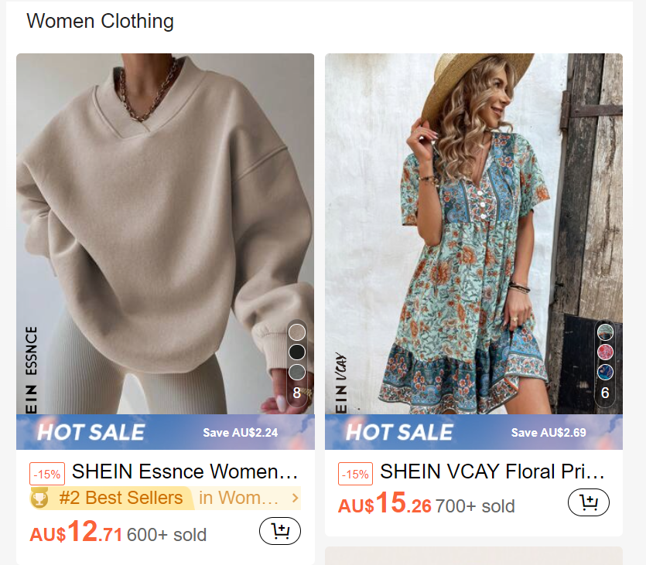
Thanks to aggressive and social media presence, Shein and Temu have extraordinary brand awareness in Australia
91% online shoppers are aware of Temu
29%
online shoppers have tried Temu at least once
70% online shoppers are aware of Shein
20% online shoppers have tried Shein at least once
Source: Roy Morgan SMS Poll, Mar’24
Base: Australian Population Over 18+ who have ever shopped online (92% of total population 18+)
Notes:
Much of Shein and Temu’s success in Australia is a result of massive media investment and social media marketing, which has driven unparalleled levels of brand awareness and trialling for these once little-known online platforms.
Temu is reported to have spent $3-4 billion on marketing in 2023 globally.
As a result, now 91% of shoppers are aware of Temu, and 70% of Shein, motivating huge numbers of people to trial them.

Slide 23
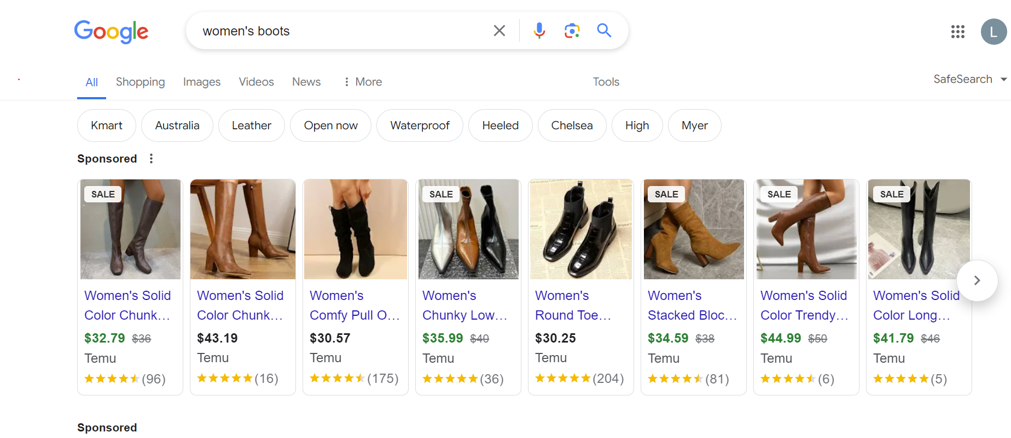
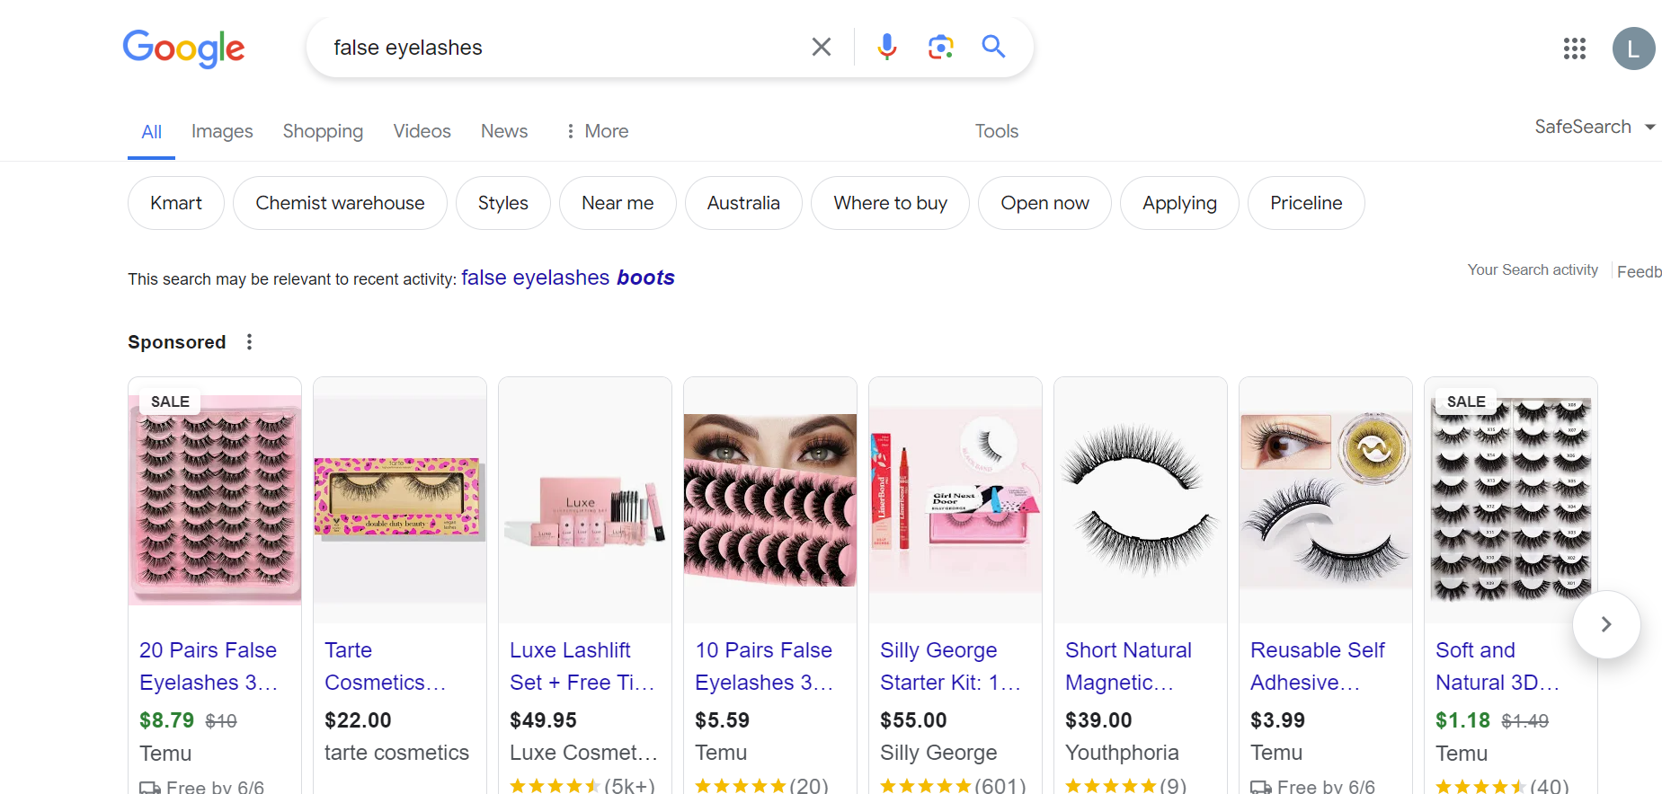

Slide 24
In the US, Shein and Temu have huge customer numbers – about a third of the population shops each month

Slide 25
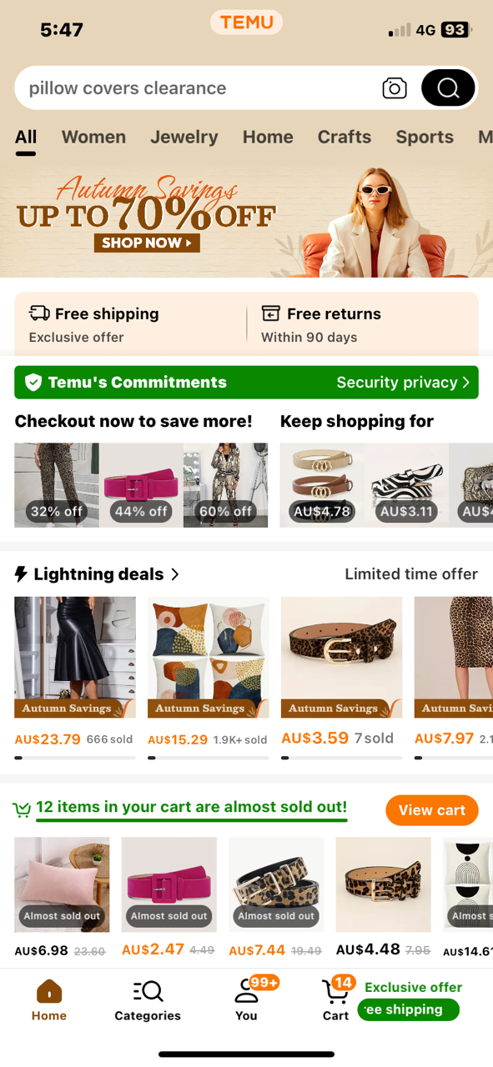
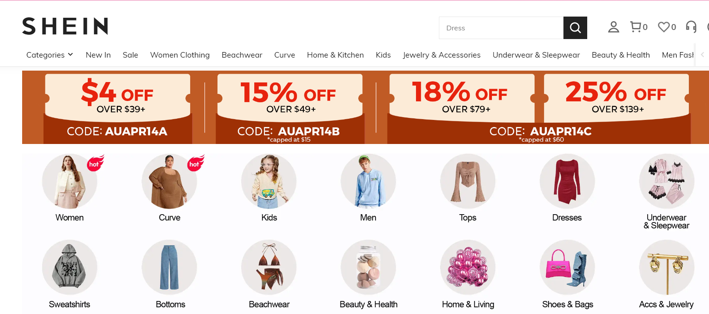
Who’s shopping on Temu & Shein and why?
Notes:
So, who’s driving this phenomenal rise – and why?

Slide 26
The Temu shopper profile is mostly in line with the average Australian, while Shein shoppers are more likely women, aged <35, and young parents
(ix=36)
Men
Men
(ix=154)
(ix=145)
Women
(ix=123)
(ix=145)
(ix=122)
(ix=132)
Women
Source: Roy Morgan Single Source, Apr’23 – Mar’24
Base: Australian Population Over 14+
ix = Index compared to Total 14+ Population
Notes:
Much like Amazon, a mix of Australians are shopping on both Shein and Temu, but there are some key cohorts driving the rise.
Young families—always keen to make their dollars stretch further—are more likely to shop on Shein, along with larger households.
What’s really interesting - is that older and retired Australians are also more likely to shop on Temu.

Slide 27
Not surprisingly price, product range and free delivery are the big drivers in converting customers
“Cheap and broad range of products, especially clothes.”
“Cheap, free shipping, large range.”
“Some of their products are good and availability is easy, fast delivery.”
“Fun cheap and easy.”
“For the cheap products that I don’t need to last long.”
“They have so much variety and different things that we don’t see here in our major stores and some of their things are reasonably priced.”
Source: Roy Morgan SMS Poll, Mar’24
Base: Australian Population Over 18+
Notes:
When we asked people WHY they shopped on Shein and Temu, price and an extensive product range were the big drivers.

Slide 28
But not everyone buys again after being disappointed with the quality of products, concerns about ethics and privacy and being bombarded with advertising
“I don’t buy anymore. It’s fast fashion and poorly made. And the sizing isn’t suitable for Australians.”
“Exploits slave labour and manipulates people into thinking they’re winning, like gambling.”
“It was cheap but terrible. Won’t shop there again.”
“Kids did an order. As anticipated, horrible quality, synthetic fabrics, disposable fashion at its best/worst.”
“Did it once, item failed on first use. Never again. ”
“Ordered because it was cheap, arrived improperly packed and damaged, deleted app but flooded my Facebook with ads.”
“I didn’t realise it was so unethical. The quality was very poor, I never purchased again.”
Source: Roy Morgan SMS Poll, Mar’24
Base: Australian Population Over 18+
Notes:
But not everyone is happy with the quality of products arriving at their door. Many are deciding never to shop with them again.
Others are feeling uneasy about the ethics of ultra-cheap retail
As these research participants put it, “Shein is the best and worst of disposable fashion,”
And of Temu, it “exploits slave labour and manipulates people into thinking they are winning like gambling.”

Slide 29
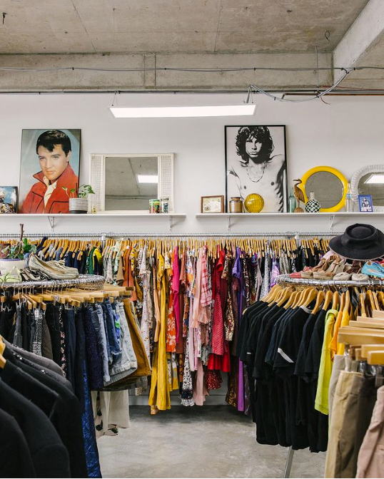
While some Australians embrace throw-away retail, a trend in the opposite direction quietly continues – the Circular Economy
BUY secondhand items
SELL items no longer wanted
57% 12.2 million Australians
44%
9.3 million Australians
Circular Economy
34%
7.3 million
do both: BUY & SELL second hand
Source: Roy Morgan SMS Poll, Apr’24
Base: Australian Population Over 18+
Notes:
Amid the rise of ultra cheap throw-away retail - a trend in the opposite direction quietly continues
57% of Australians buy second-hand, and 44% sell items they no longer want.
Together they make up the Circular Economy – defined as people who do both – that’s 7.3 million people – buying AND selling on the second-hand market.

Slide 30
Shopping more sustainably and saving money are key drivers behind buying second hand but 1 in 10 buy out of necessity
1 in 10 second hand shoppers buy because they can’t afford to buy new
29% buy because its sustainable
“Can’t afford to buy anything full price. Mortgage interest is really hurting us, cost of living, energy prices.”
“Lower environmental impact. I like not contributing to overconsumption culture, reduce landfill.”
67% buy for good quality items at much cheaper prices
“Life is so expensive, I have no other choice.”
“Better quality products for lower cost. Often almost as good as new.”
Source: Roy Morgan SMS Poll, Apr’24
Base: Australian Population Over 18+
Notes:
When we asked consumers why they buy second hand, the desire to shop more sustainably remains a key driver - on top of cheap prices.
But some told us that buying second hand has become a necessity over the last year – that they can’t afford to buy items new because of the cost of living.

Slide 31
Some parting thoughts: The cost of living crisis is driving people to opposite extremes – throw away retail or second hand Temu and Shein are thriving amid the cost-of-living crisis but their future is unknown as we wait to see if poor quality and ethical concerns drive customers away
Australian retailers have an opportunity to learn from their Playbook:
There’s a very real market for ultra-cheap retail, and many people are willing to trade down in quality for price
‘Buying’ customers via media spend really does work and very quickly
The gamification of online shopping really works!
There’s a strong opportunity to go in the opposite direction – ramp up your credentials around quality, ethics and authenticity
Notes:
In the meantime, Australian retailers can learn from their playbook:
There’s a very real market for ultra-cheap retail, and many people are willing to trade down in quality for price
‘Buying’ customers via media spend really does work and very quickly
The gamification of online shopping really works!
There’s a strong opportunity to go in the opposite direction and take the PREMIUM ‘moral high ground’ – ramp up your credentials around quality, ethics and authenticity

Slide 32
Thank you
Notes:
That brings my address to an end.
Now it’s back to you Michele.
MICHELE:
Thanks, Laura. That was excellent - and scary. Now, I’d like to ask Paul Zahra to join me up here to review some of the existential trends facing Australian retail.
(After discussion with Paul ...) Thanks, Paul, and thanks to everyone for coming out this evening. I look forward to welcoming everyone back for our next event here at Roy Morgan.

